Slide 1
CONSUMER LEARNING
MODULE - 5

Slide 2
LEARNING OBJECTIVES
• Understand behavioral learning theories and their impact on marketing.
• Understand cognitive learning theories and their impact on marketing.
• Understand how marketers measure the results of consumer learning.

Slide 3
INTRODUCTION

Slide 4
CRITICAL ELEMENTS OF CONSUMER LEARNING
MOTIVATION: UNFULFILLED NEEDS ARE THE UNDERLYING DRIVERS
CUES: THE STIMULI THAT SUGGEST A SPECIFIC WAY TO SATISFY YOUR MOTIVATIONS
RESPONSE: THE CONSUMERS’ REACTION TO A CUE
REINFORCEMENT: THE REWARD—THE PLEASURE, ENJOYMENT AND BENEFITS—
THAT THE CONSUMER RECEIVES AFTER BUYING AND USING A PRODUCT OR SERVICE

Slide 5
BEHAVIOURAL LEARNING THEORIES

Slide 6
BEHAVIOURAL LEARNING THEORY
BEHAVIORAL LEARNING THEORY FOCUSES ON DEFINING THE PROCESS OF CONSUMER LEARNING IN TERMS OF AN ASSOCIATION BETWEEN A STIMULUS AND A RESPONSE

Slide 7
BEHAVIORAL LEARNING THEORY
The stimulus is an external object, person, or marketing communication (or any other form of external stimuli that the consumer perceives).
The consumer’s response is the observable action the consumer takes when reacting to stimuli he or she comes across in the environment.

Slide 8
THREE FORMS
There are three forms of behavioral learning that marketers rely on
in their daily roles:
• Classical Conditioning
• Instrumental Conditioning
• Observational Learning

Slide 9
CLASSICAL CONDITIONING
Classical conditioning focuses on the automatic response that humans develop through repeated exposure and reinforcement.
Russian scientist Ivan Pavlov pioneered the theory of classical conditioning.

Slide 10
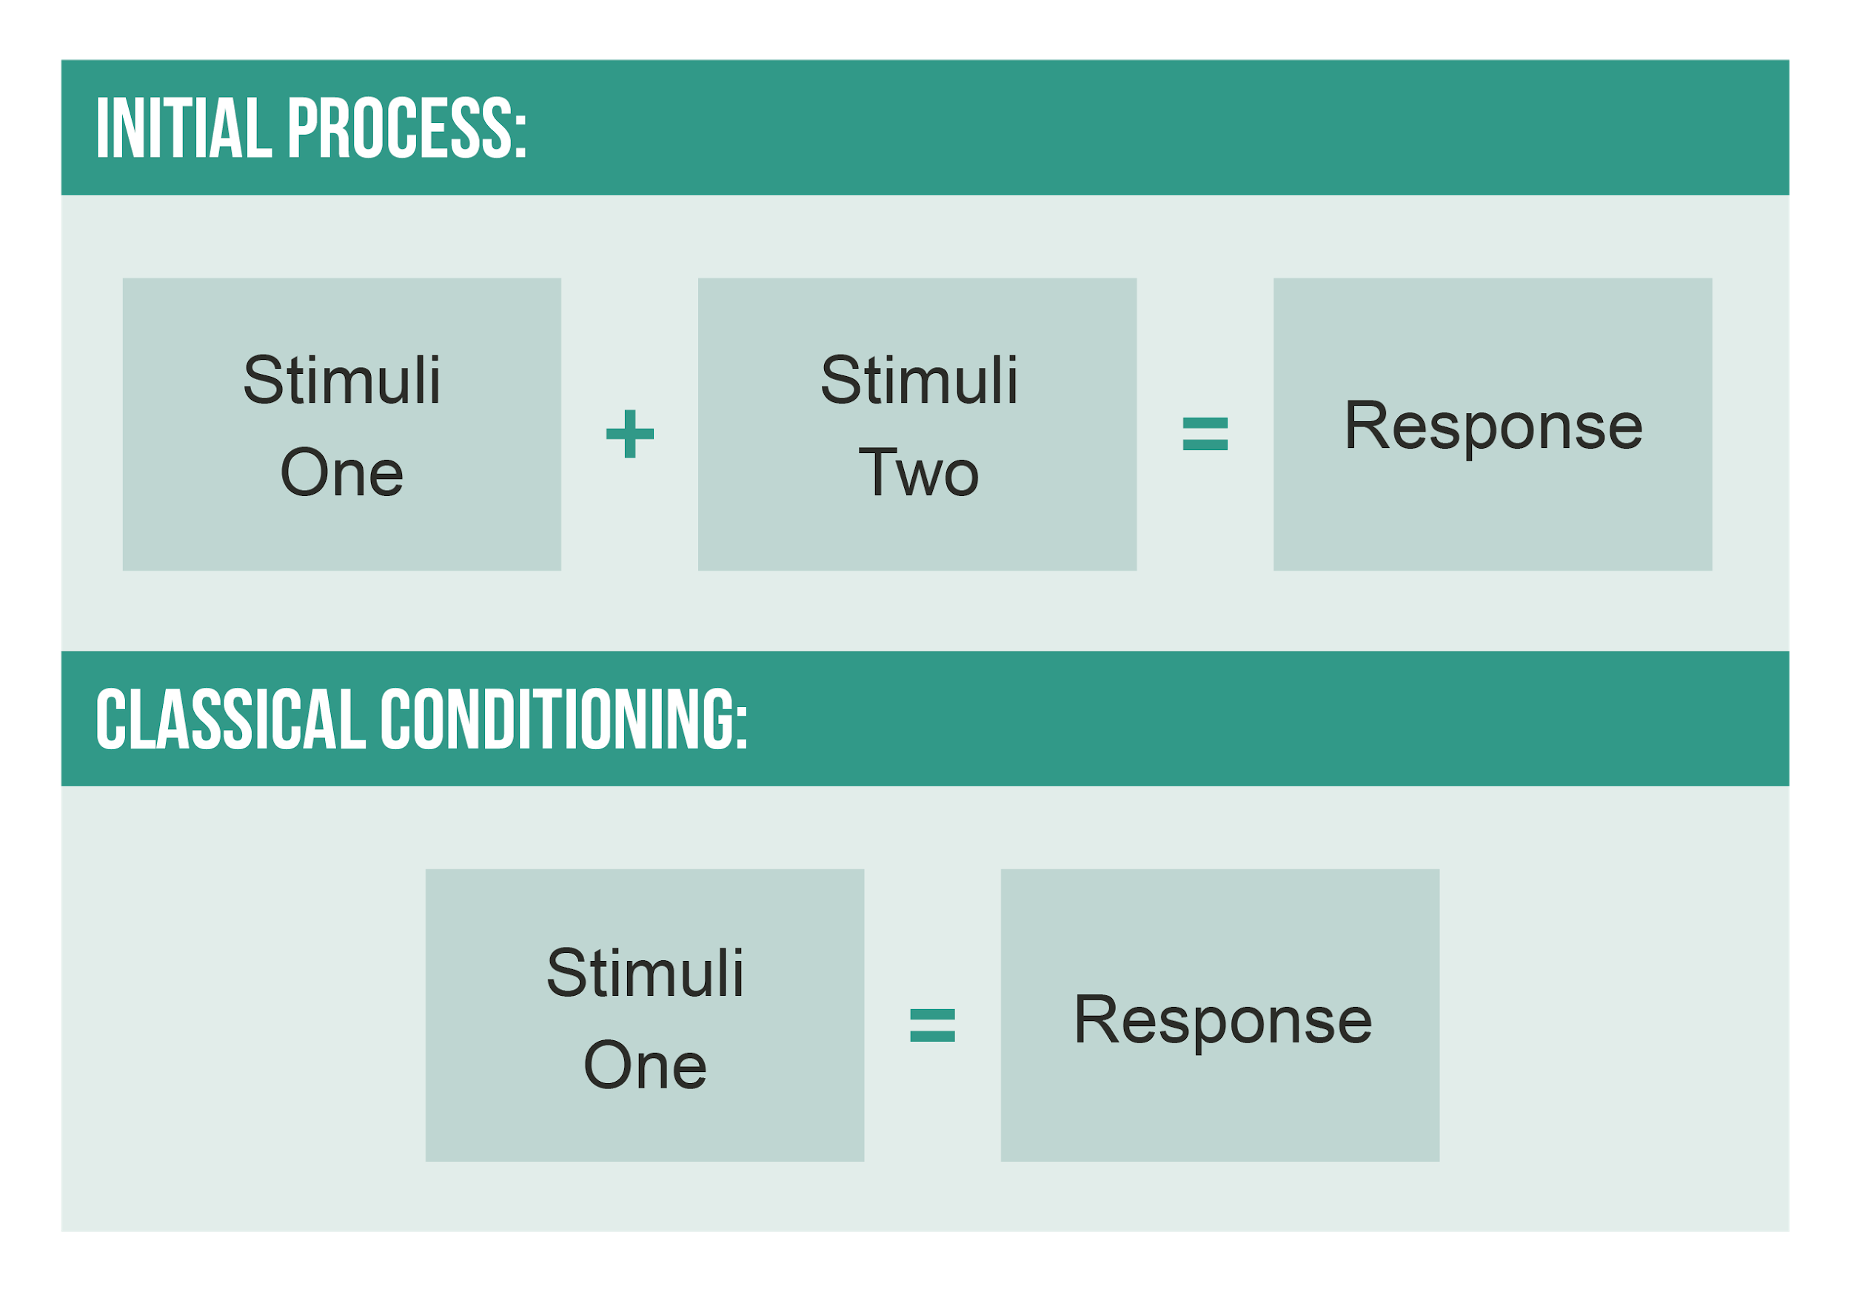

Slide 11
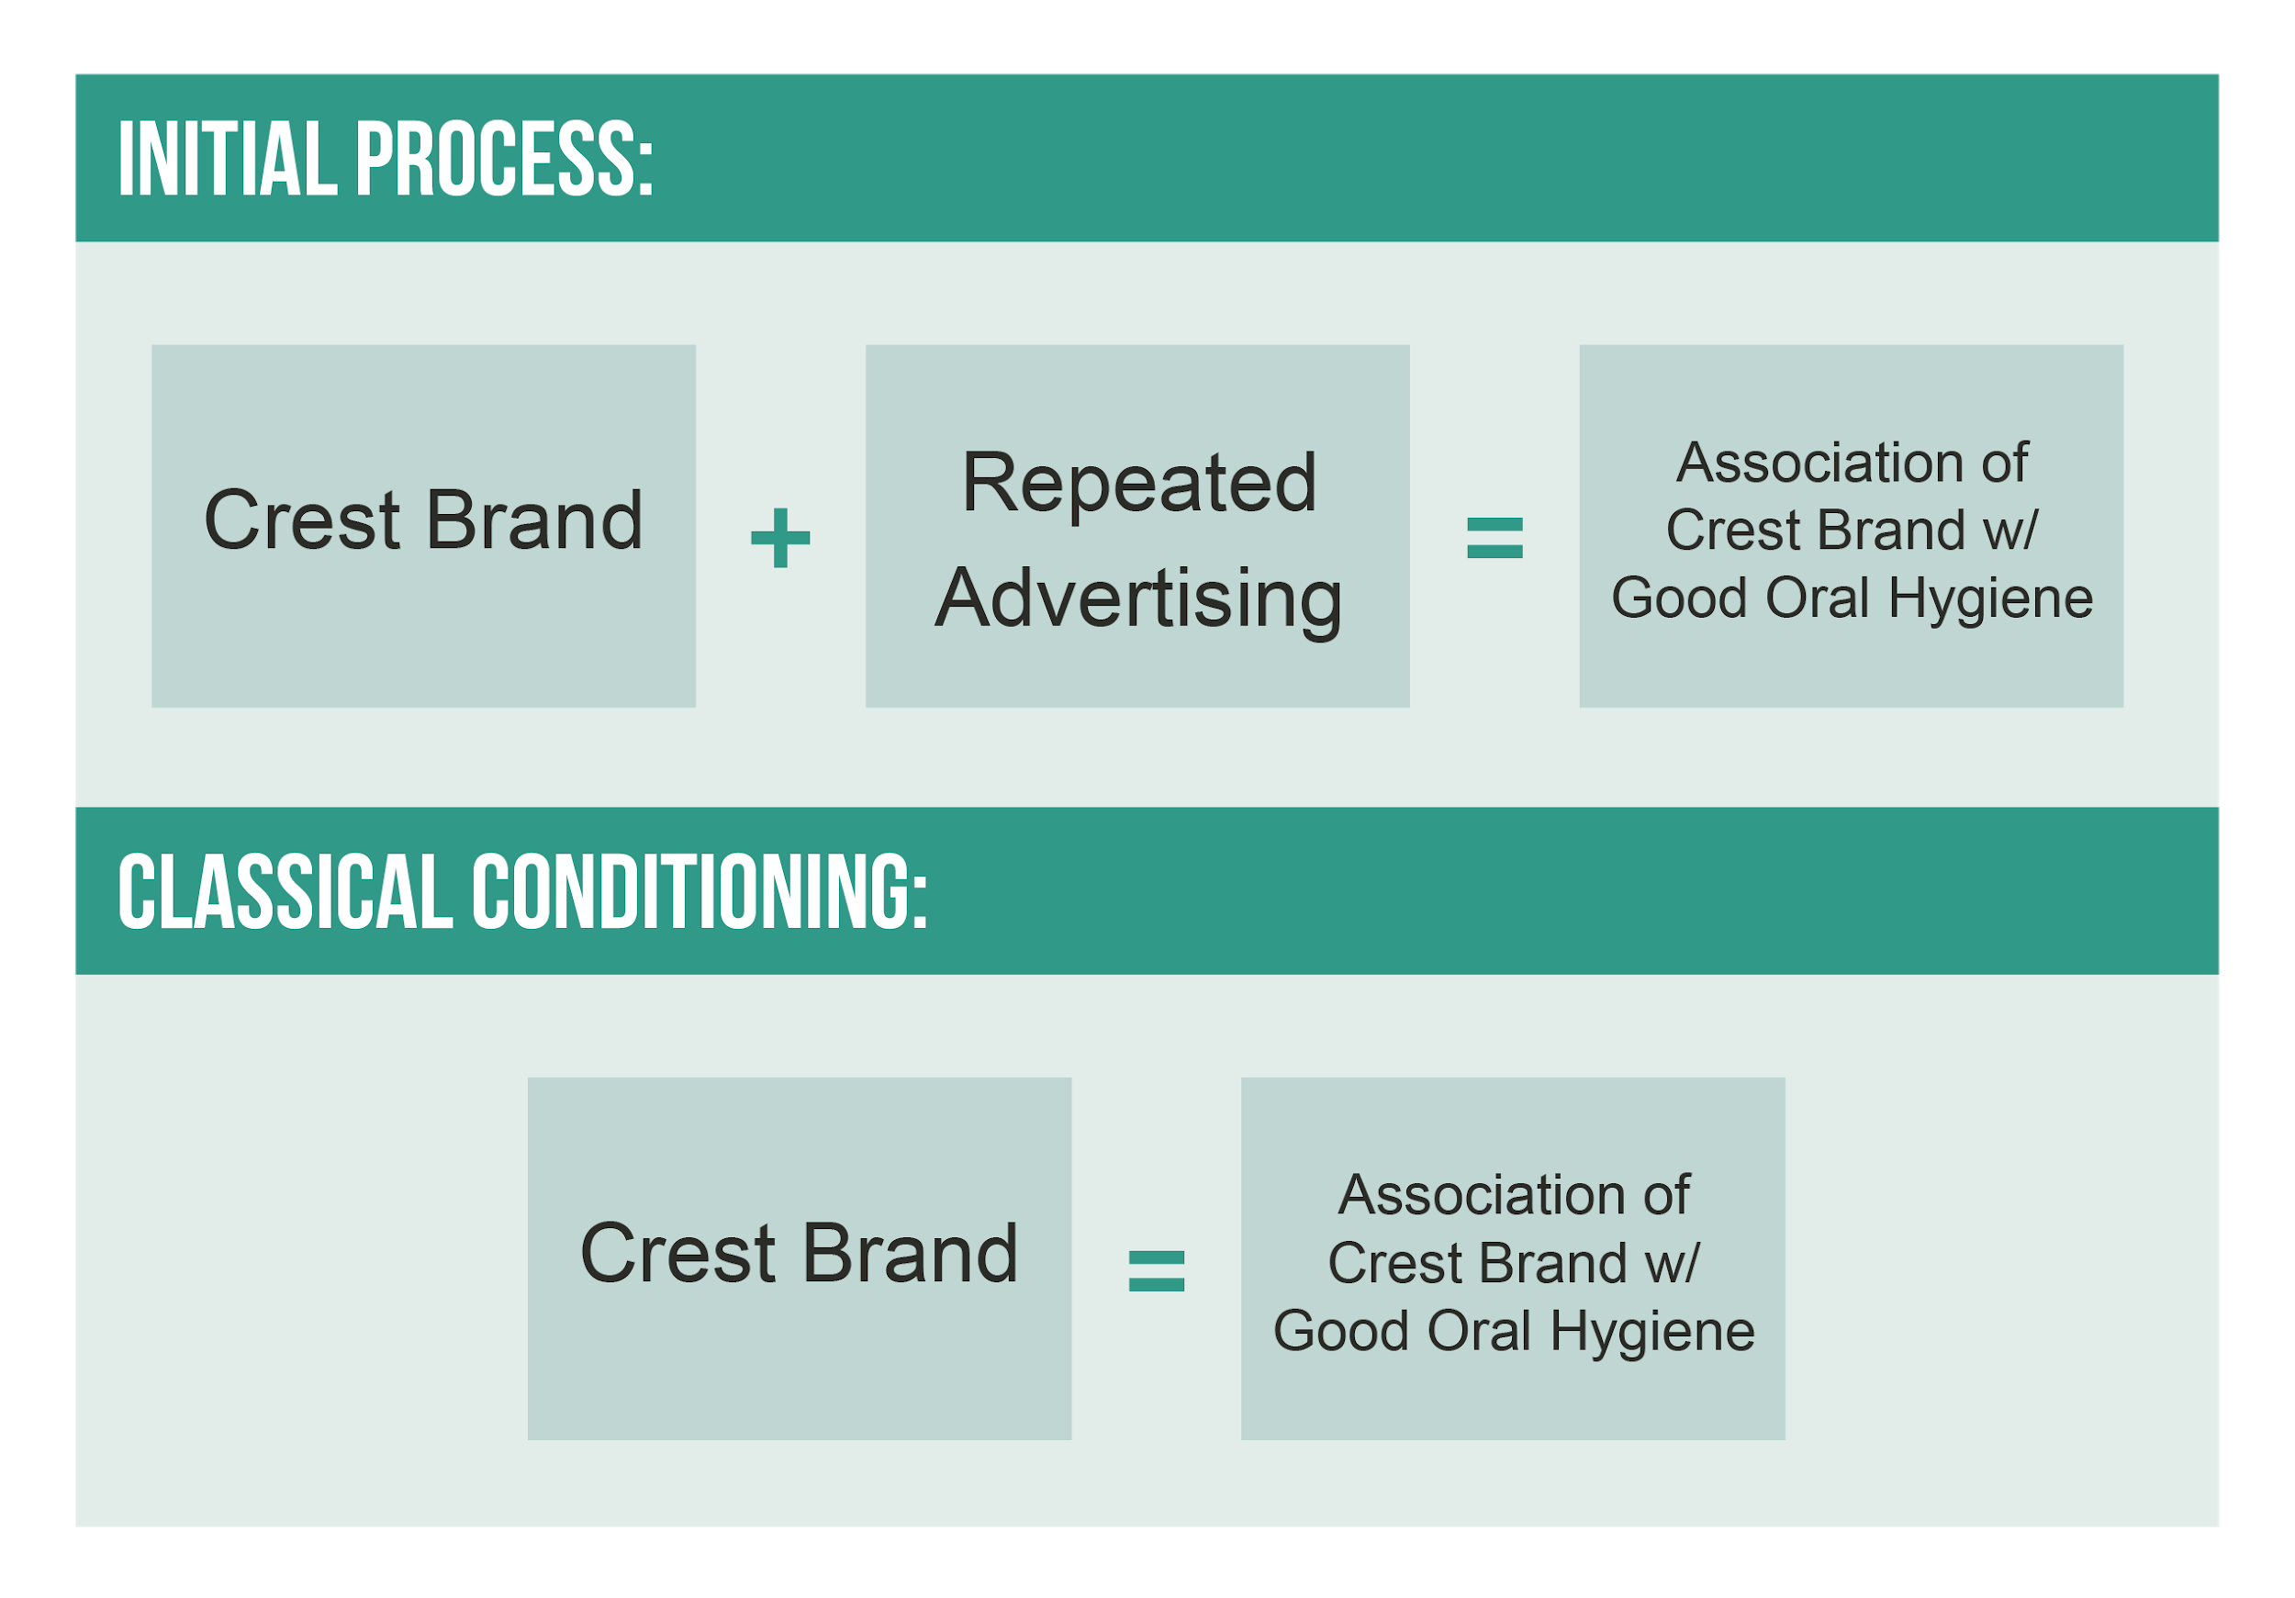

Slide 12
CLASSICAL CONDITIONING: PAVLOV’S THEORY
There are several ways marketers can apply Pavlov’s theory
to their roles:
Repetition
Stimulation Generalization
(Product form extension- product line extension, brand extension)
Application of classical conditioning in Marketing

Slide 13
INSTRUMENTAL CONDITIONING
The second form of behavioral learning we will study is instrumental conditioning, sometimes referred to as operant conditioning.
The instrumental conditioning model, constructed by American psychologist B.F. Skinner, is based on the notion that learning occurs through a trial-and-error process.
Skinner's experiment
Application of Operant Conditioning in Marketing

Slide 14
OBSERVATIONAL LEARNING
The third type of behavioral learning that we will study is called observational learning. As the name suggests, observational
learning is the process by which humans learn by observing
the behavior of others.

Slide 15
OBSERVATIONAL LEARNING
According to psychologist Albert Bandura’s research, observational learning is more likely to occur in the following three cases:

Slide 16
OBSERVATIONAL LEARNING
1. When we are observing people
• we believe are warm or nurturing and in whose presence
we feel comfortable
• who are in an authoritative position
• who are similar to us in some way
• whom we admire due to accomplishments or social status

Slide 17
OBSERVATIONAL LEARNING
2. When we view people getting rewarded for their behaviors
or when you have been rewarded for similar behavior
in the past

Slide 18
OBSERVATIONAL LEARNING
3. When we lack confidence or a situation is confusing or unfamiliar

Slide 19
LEARNING OBJECTIVE: 2
COGNITIVE LEARNING THEORIES

Slide 20
COGNITIVE LEARNING
Cognitive learning is primarily concerned with how information
is processed by the human mind: how it is stored, retained,
and retrieved.

Slide 21
COGNITIVE LEARNING
Cognitive learning emphasizes the role of gathering facts
about the products or services being considered, processing
those facts and recalling them—rather than the repetition
and association of rewards with the stimuli that are the hallmark
of behavioral learning.

Slide 22
COGNITIVE LEARNING
Factors that can affect a consumer's ability to practice
cognitive learning include their
• familiarity with the information
• relevance of the information
• interest in the information
• ability to process the form in which the information is provided

Slide 23
COGNITIVE LEARNING
Cognitive processes:
• information processing
• storing information
• retaining and retrieving information

Slide 24
COGNITIVE LEARNING OVERVIEW
Cognitive theorists believe that learning is a complex mental process
that happens because consumers make the conscious choice
to process information and store that information in their brains.

Slide 25
COGNITIVE LEARNING OVERVIEW
Cognitive learning has four core elements:
1. Cognitive effort
2. Cognitive structure
3. Information analysis
4. Elaboration

Slide 26
LEARNING OBJECTIVE 3
RESULTS OF
CONSUMER LEARNING

Slide 27
MEASURING SUCCESS
Marketers are often interested in measuring the success
of their efforts to induce consumer learning:
Recognition and Recall Measures
Brand Loyalty Measures

